Slide 1
Exploring Cryptography Protocols
with Limited Emphasis on Mathematics ☺
Presented By
@7eRoM

Slide 2
Attention
These slides have been crafted using the foundation of my MSc course in Cryptography Protocols at the University of ISfahan.
I've made adjustments to the content to align with the specific objectives of this presentation.
Also, My intention has been to minimize the use of mathematical concepts, which may result in some concepts being simplified or less precise.
Presented By
@7eRoM

Slide 3
Agenda
Identification and Entity Authentications Protocols
Zero Knowledge Protocols
Key Establishment Protocols
Threshold Cryptography and Secret Sharing Protocols
Special Purpose Protocols (like simultaneous contract signing, mental poker, fair exchange)
Identity Based Cryptography
Types of Digital Signatures
Secure Multiparty Computations

Slide 4
Secret Sharing
Content
Secret Splitting
Secret Sharing (SS)
Threshold Secret Sharing (TSS)
Verifiable Secret Sharing (VSS)
Key Escrow Systems (KES)
Proactive Secret Sharing (PSS)

Slide 5
Secret Sharing
Secret Splitting
Given a secret s, we would like n parties to share the secret so that the following properties hold:
All n parties can get together and recover s.
Less than n parties cannot recover s.

Slide 6
Secret Sharing
Secret Splitting – Map Example
You and your friend accidentally discovered a map that you believe would lead you to an island full of treasure.
You and your so-called friend do not really trust each other
Here the map is s.
We split the secret into n pieces s₁, s₂, . . ., s_{n} and give one piece to each party.
Each piece here is called a share.

Slide 7
Secret Sharing
Secret Splitting – Salary Example
Assume that your salary is stored as a number 12345678.
You want to split your salary into two shares for two parties.
We can apply the same approach as we did to the map.
We can split the digits into two sets and give one set to each party as a share.
For example, can give the first 4 digits to party 1 and the other 4 to party 2.
The first party who gets the most significant 4 digits of your salary. It is true that he doesn't know exactly how much your salary is, but he has a pretty good idea about the range of your salary (>= 12340000)
1234
5678
Partial Information Disclosure

Slide 8
Secret Sharing
Partial Information Disclosure
A share may not contain all the information about a secret, but could disclose partial information.
In certain cases, such partial information disclosure could be fatal.

Slide 9
Secret Sharing
Secret Splitting – Password Example
Two parties are going to share a password.
Here a password consists of 8 characters, with each selected from a set of 100 possible characters.
If we split the password into two shares and each share has 4 characters of the password
Then each share effectively gives out the secret under a brute-force attack.
There are 100⁸ possible passwords. If it takes 1 microsecond to generate and check one password, then it takes 100⁸ * 10⁻⁶ seconds ~ 300 years.
For a party, there are only 100⁴ possible passwords to check against. It would only take 100⁴ * 10⁻⁶ = 100 sec to find the password.
Partial Information Disclosure

Slide 10



Secret Sharing
Secret Sharing – Password Example
Secret S
e.g. 1011010011
S₁ : random bit sequence as length as S
e.g. 0011010001
S₂ = S ⊕ S₁
Alice and Bob can generate S by
S₁ ⊕ S₂
No Information Disclosure

Slide 11
Secret Sharing
Secret Sharing – Generalized Password Example
There is a bit sequence called S that we want to share between U₁, U₂, ..., U_{n}
TTP generates random bit sequence S₁, S₂, S₃, ..., S_{n-1} (as length as S and delivers to users U₁, U₂, U₃, ..., U_{n-1}
TTP calculates S_{n} = S ⊕ S₁ ⊕ S₂ ⊕ S₃ ⊕ ... ⊕ S_{n-1} and sends to U_{n}
All users can generate S by S₁ ⊕ S₂ ⊕ ... ⊕ S_{n}
No Information Disclosure

Slide 12
Secret Sharing
Threshold Secret Sharing – Nuclear Missile Example
There is a secret key to launch the nuclear missile
There are 3 generals who are in charge of a missile launch
Give the secret code to these three generals
it is possible for a lunatic general to start a war and destroy the planet.
Each general get only one share and knows no information about the secret code
what if one general is a spy from a hostile country or even is sick or is on vacation?
Solution:
A missile can be launched with 2 or more generals
Less than 2 generals may not launch a missile.

Slide 13
Secret Sharing
(n,t) Secret Sharing
Given a secret S, to be shared among n parties, that sharing should satisfy the following properties:
Availability: greater than or equal to t parties can recover S.
Confidentiality: less than t parties have no information about S.
In the missile launch example, we are in fact using a (3,2)-secret sharing scheme

Slide 14
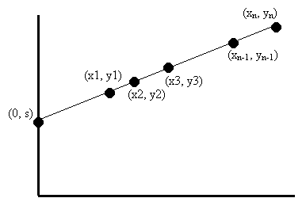
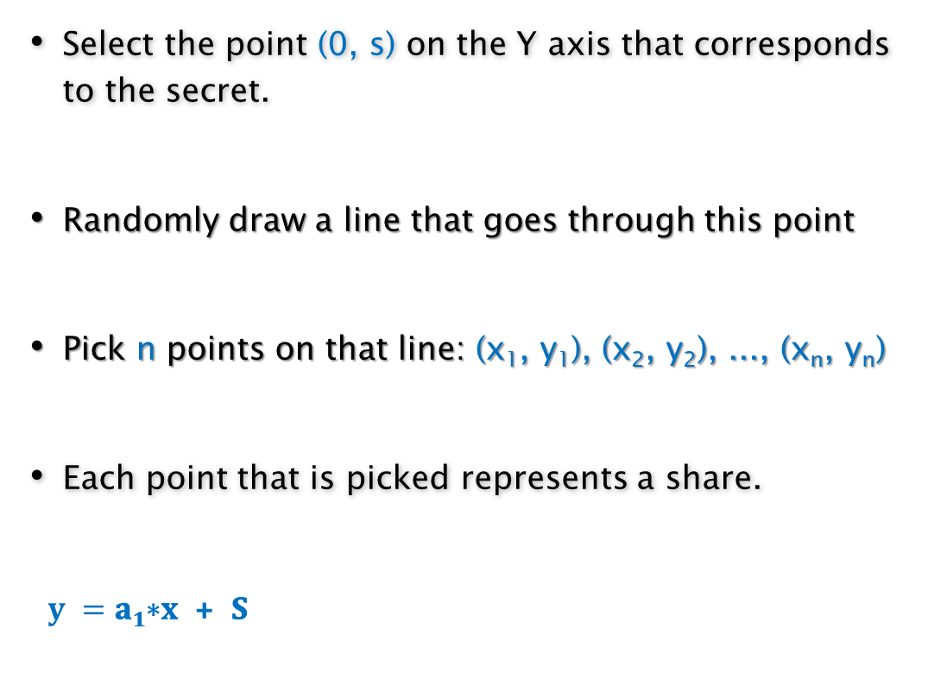
Secret Sharing
(n,t) Secret Sharing – Example t=2
Select the point (0, s) on the Y axis that corresponds to the secret.
Randomly draw a line that goes through this point
Pick n points on that line: (x₁, y₁), (x₂, y₂), ..., (x_{n}, y_{n})
Each point that is picked represents a share.
$y =\text{a}\text{1}\text{∗}\text{x} \text{+ }\text{S}$

Slide 15
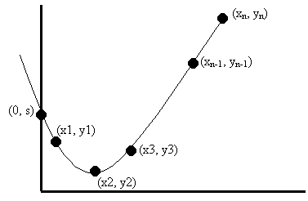

Secret Sharing
(n,t) Secret Sharing – Example t=3
$$y = a2 ∗ x2 +a1 ∗ x + S$$
Generalized for (n, t)-secret sharing scheme (Shamir - 1979)
𝐲 = 𝐚_{𝐭−𝟏}∗𝐱^{𝐭−𝟏} + 𝐚_{𝐭−𝟐}∗𝐱^{𝐭-2} + ... + 𝐚_{𝟏}∗𝐱 + 𝐒

Slide 16
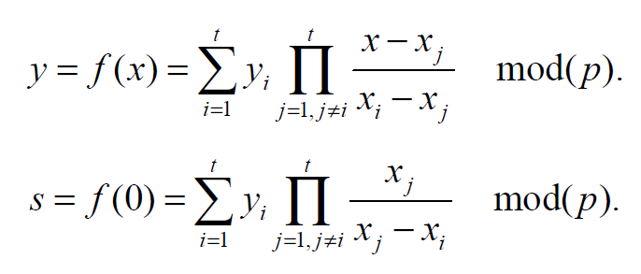
Secret Sharing
(n,t) Secret Sharing – Shamir (1979)
𝐲 = 𝐚_{𝐭−𝟏}∗𝐱^{𝐭−𝟏} + 𝐚_{𝐭−𝟐}∗𝐱^{𝐭-2} + ... + 𝐚_{𝟏}∗𝐱 + 𝐒
How to recover S?
Lagrange Interpolation

Slide 17
Secret Sharing
(n,t) Secret Sharing – Example n=5,t=3
y₁=f(1)=7+8+11=0 mod 13
y₂=f(2)=28+16+11=3 mod 13
a₁=8
a₂=7
S=11
p=13
y = 7x²+8x+11 mod 13
y₃=f(3)=63+24+11=7 mod 13
y₄=f(4)=112+32+11=12 mod 13
y₅=f(5)=175+40+11=5 mod 13
Suppose u₂ , u₃ and u₅ wants to recover the secret S
(1,0)
(2,3)
(3,7)
(4,12)
(5,5)
1
2
3
4
5

Slide 18
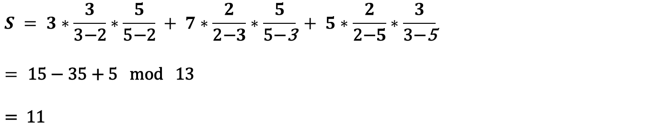
Secret Sharing
(n,t) Secret Sharing – Example n=5,t=3
2
(2,3)
3
(3,7)
5
(5,5)
$$S = 3∗\frac{3}{\text{3}\text{−}\text{2}}∗\frac{5}{\text{5}\text{−}\text{2}} + 7∗\frac{2}{\text{2}\text{−}3}∗\frac{5}{\text{5}\text{−}\text{3}} + 5∗\frac{2}{\text{2}\text{−}5}∗\frac{3}{\text{3}\text{−}\text{5}}$$
$$=\text{ 15 }\text{− }\text{35 }\text{+ }\text{5 }\text{mod} \text{13 }$$
$$\text{= }\text{11}$$

Slide 19
Secret Sharing
Verifiable Secret Sharing
What if a user is malicious?
The shares must be verifiable

Slide 20
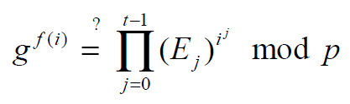
Secret Sharing
Verifiable Secret Sharing – Shamir Scheme
Initialization
Random big prime P
Generator g
Public version of secret: E₀ = g^{s} mod p
Generate polynomial function
Choose random a₁, a₂, ..., a_{t-1}
f(x) = a_{t-1} * x^{t-1} + a_{t-2} * x^{t-2} + ... + a₁ * x + S mod p
Sending (i , f(i)) to user u_{i}
Broadcasting E_{j} = g^{aj} mod p for j=1,2,...,t-1
Verification by each user through
Recover secret S as before

Slide 21
Secret Sharing
Key Escrow System
Ability of secure connection between two citizens though an unsecure channel
Ability of restoring of messages of particular citizens
Avoid of possible misuse of government representatives
So, here is a paradox:
Citizens need to privacy and secure connection
Government needs to considering the connections

Slide 22
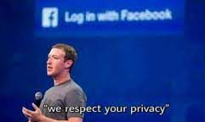
Secret Sharing
Key Escrow System
So, What is the solution?
Oh no, Thanks!

Slide 23
Secret Sharing
Key Escrow System
Types of trust in government
Full trust in the government.
Complete distrust in the government; requiring permission from all representatives to restore the key.
Partial trust in representatives; requiring permission from t representatives out of n representatives to restore the key.

Slide 24
Secret Sharing
Key Escrow System - Diffie-Hellman
Secret d = X₁+X₂+...+X_{n} mod p
Public Key e=g^{d} mod p
X₁
X_{n}
Government
Representative
Honest
Representative 1
...
Honest
Representative n

Slide 25
Secret Sharing
Key Escrow System - Diffie-Hellman
Secret d = X₁+X₂+...+X_{n} mod p
Public Key e=g^{d} mod p
i=1:n , P_{i}=g^{Xi} mod p
Government
Representative
P₁
?
P_{n}
e = P₁.P₂. ... .P_{n}
Honest
Representative 1
...
Honest
Representative n
?
?
P₁ = g^{X1}
P_{n} = g^{Xn}

Slide 26
Secret Sharing
Key Escrow System – Diffie-Hellman
Reducing probability misuse of government representatives
The citizen can prevent restoring the key by coalescing with just one representative
Solution: Using Verifiable Secret Sharing instead of Secret Splitting
The scheme is secure against coalition of the citizen with n-t representatives

Slide 27
Secret Sharing
Proactive Secret Sharing
Suppose a secret S has been shared between 3 servers using a (3,2) secret sharing scheme.
If one of the servers is compromised, and the adversary gains access to its share, there is a potential risk that the adversary could acquire shares from other servers, allowing them to reconstruct the secret.

Slide 28
Secret Sharing
Proactive Secret Sharing
In a (n,t) secret share, what if a share would be disclosed?
S_{A}+S_{B}=S mod p
Sends S_{A1} through a secure channel
S_{B1}+S_{B2}=S_{B} mod p
S_{A1}+S_{A2}=S_{A} mod p
Sends S_{B1} through a secure channel
S_{A2}+S_{B1}=S'_{A} mod p
S_{A1}+S_{B2}=S'_{B} mod p

Slide 29
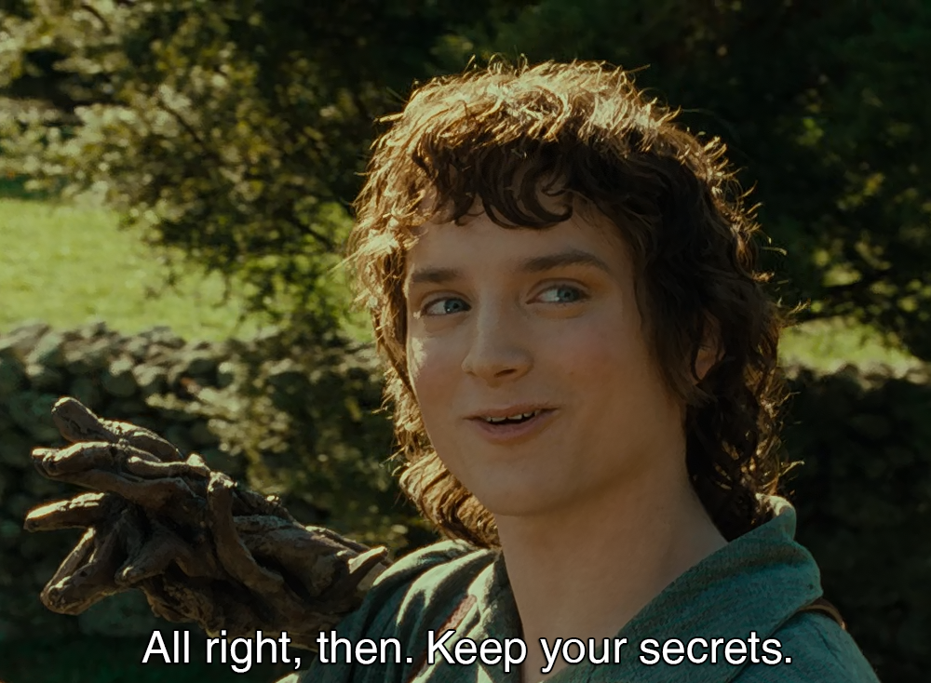

Slide 30
Ref
Cryptography Protocols Course, Dr. Hamid Mala, University of Isfahan
https://www.cs.cornell.edu/courses/cs513/2000SP/SecretSharing.html
https://www.iconfinder.com/UsersInsights
https://www.iconfinder.com/Chanut-is
https://www.iconfinder.com/iconsets/softwaredemo

